Slide 1
Camera Calibration
VIDEO ANALYTICS
CS/SE 6327
Spring 2017
Instructor: B. Prabhakaran
TA: Kevin Desai (Kevin.Desai@utdallas.edu)

Slide 2
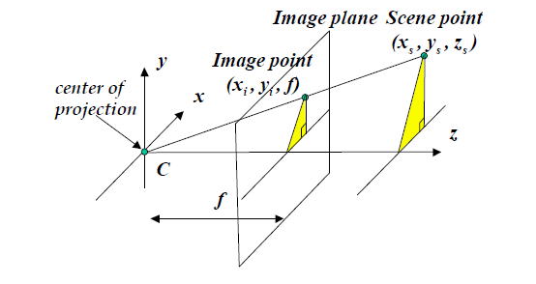



The pinhole Camera

Slide 3
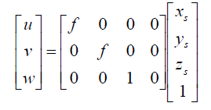

Perspective projection
Notes:
https://en.wikipedia.org/wiki/Camera_resectioning
Often, we use {\displaystyle [u\,v\,1]^{T}} to represent a 2D point position in pixel coordinates. {\displaystyle [x_{w}\,y_{w}\,z_{w}\,1]^{T}} is used to represent a 3D point position in World coordinates. Note: they were expressed in augmented notation of Homogeneous coordinates which is the most common notation in robotics and rigid body transforms. Referring to the pinhole camera model, a camera matrix is used to denote a projective mapping from World coordinates to Pixel coordinates.
Zc [u,v,1] = K [R T] [Xw,Yw,Zw,1]
Intrinsic parameters
K = [Ax G Ux 0, 0 Ay Vy 0, 0 0 0 1]
The intrinsic matrix K contains 5 intrinsic parameters. These parameters encompass focal length, image sensor format, and principal point. The parameters Ax = f . Mx and Ay = f . My represent focal length in terms of pixels, where Mx and My are the scale factors relating pixels to distance and f is the focal length in terms of distance. G represents the skew coefficient between the x and the y axis, and is often 0. Ux and Uy represent the principal point, which would be ideally in the centre of the image.

Slide 4


Generally distances are measured in mm/cm. But for image, distance can be measured in terms of pixels. Hence we need to know resolution of camera in pixels/mm and

Slide 5
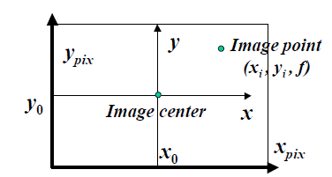


If origin of 2D coordinate system does not coincide with where z axis coincide with image plane, we need to translate it to center of image

Slide 6
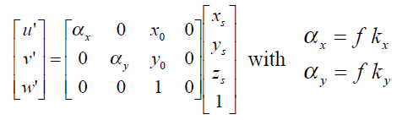

Intrinsic Matrix

Slide 7
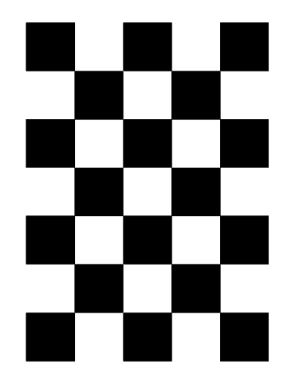
To calibrate the camera:
Checkered board pattern

Slide 8
Steps:
Select a pattern, download, and print
Paste the pattern onto a rigid flat surface
Take many pictures of the target at different orientations and distances
Make sure entire pattern is visible in every frame
Pattern should be 7x5 or 9x7
Find the corners in checkered board image using opencv function findChessboardCorners()
measure actual size of square in checkered board pattern.
Find coordinate of each corner in real world considering center of plane as origin

Slide 9
Use these two sets of corner points as input to function calibrateCamera() to find the intrinsic matrix for your camera
Use these values and size of reference object to find the size of another object placed at same distance from camera

Slide 10
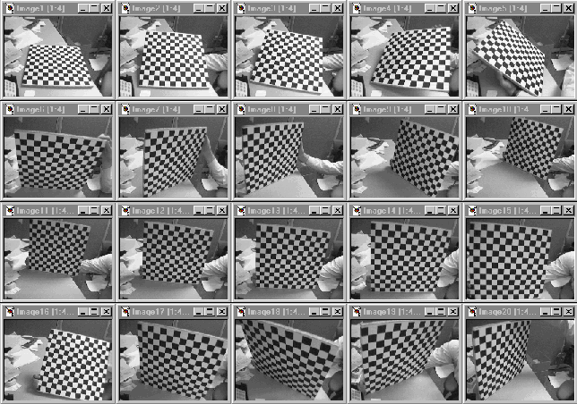

Slide 11
